Slide 1
Toronto Business District Analysis

Slide 2
Content
Introduction
Result and Discussion
Conclusion and Outlook

Slide 3
Introduction

Slide 4
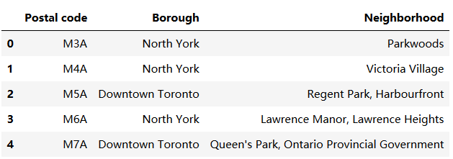
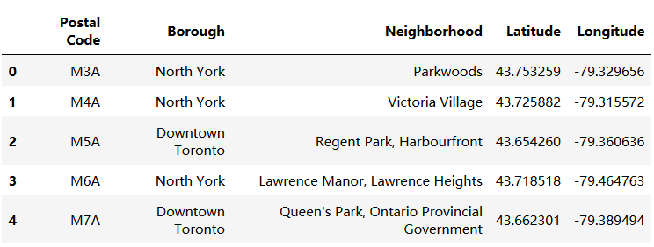
Result and Discussion

Slide 5
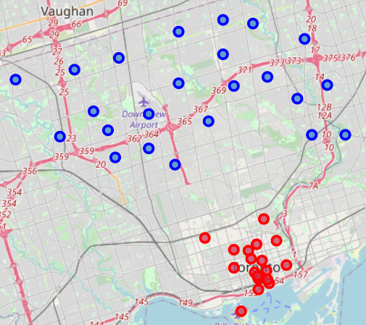
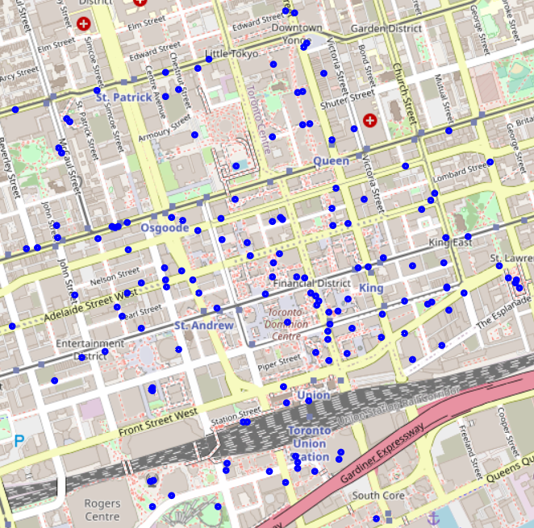
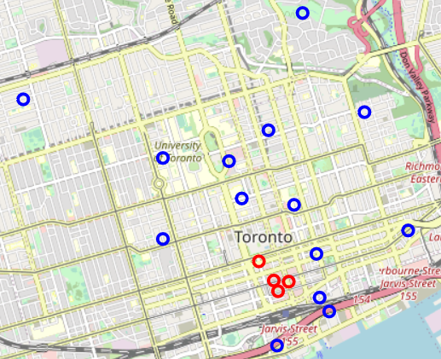
Result and Discussion

Slide 6
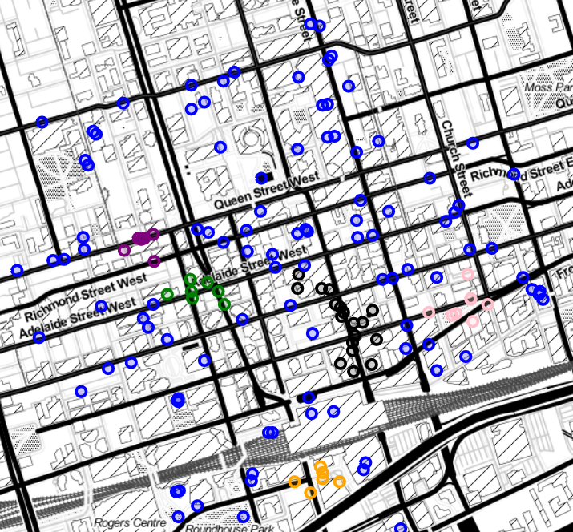
Result and Discussion

Slide 7
Conclusion and Outlook

